Slide 1
EUROPASS MOBILITY WORKING GROUP
NEC meeting Bratislava, 28.-30.2022

Slide 2
GOOD PRACTICES AND DEVELOPPMENTS
EXAMPLES OF ACTIVITIES
NEC Czeck Republic
NEC Germany
NEC Austria
NEC Hungary
NEC Slovenia

Slide 3
NEC CZECK REPUBLIC: Europass mobility – PDF version and pilot in 2022
Irena Palánová, Dagmar Svobodová
irena.palanova@npi.cz, dagmar.svobodova@npi.cz

Slide 4
1. Europass = digital services
Europass profile, portfolio, CV, cover letter, etc. ….since 2020
Test your digital skills ...since 2021/2022
Europass mobility as MS Word……?

Slide 5
Europass mobility
Trends and reasons for a change
Europass mobility templates in MS WORD (updates in 2020) what now?
MS Word is not suitable for online solutions and communication, digital signature, etc.
Examples from other countries (DE, AU,NL, SLO, DK)
Green and digital, Erasmus 2021-2027

Slide 6
Europass mobility
Solution and its benefits
Digital PDF form is available since 05/2022
modern design
Enables digital signature of the tutor
PDF template - three most used versions of the template
Free to download without any code
Compatible with Europass portoflio and other services
Notes:
- odpadá administrativní procedura žádosti a získání kódu.

Slide 7
Europass mobility
Testing with schools (mobility projects) in 12/2021
Faster procedure
No changes in the structure of the template
Better presentation of sending and host organisations as well
Responsibility for the content and signature remains the same.

Slide 8
Europass mobility
Benefits for stakeholders
e.g. National Erasmus Agency, Youth Institutions
Clear and available form, shorter procedure
Easier to present and explain to target groups

Slide 9
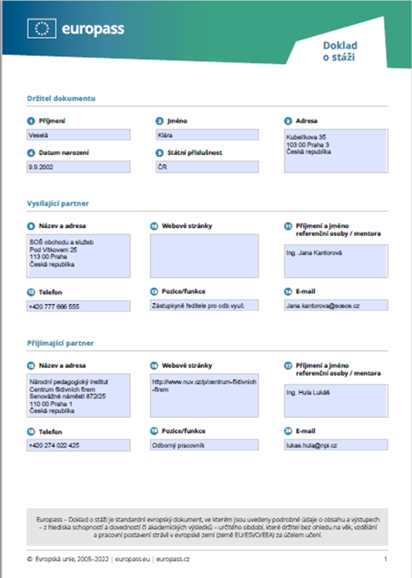
Europass mobility 2022
Clear and useful
Compatible and easy to recognize
sectors of School Education, VET, Youth and Volunteering activities

Slide 10
Stay healthy and stay skilled

Slide 11
Good practice NEC Germany
Franziska Bopp
Bopp@bibb.de

Slide 12
Online Video Helpcenter (DE/EN)
2. Europass Mobility Award Ceremony in the European Parliament

Slide 13
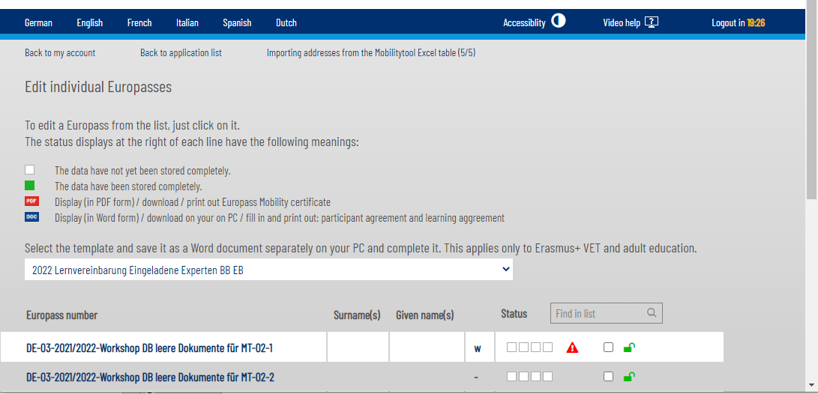
Online Video Helpcenter (DE/EN)

Slide 14
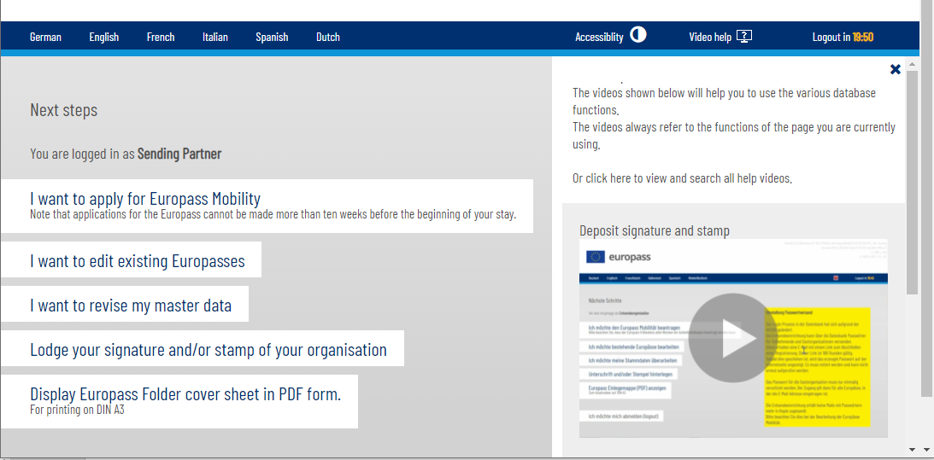
Online Video Helpcenter (DE/EN)

Slide 15
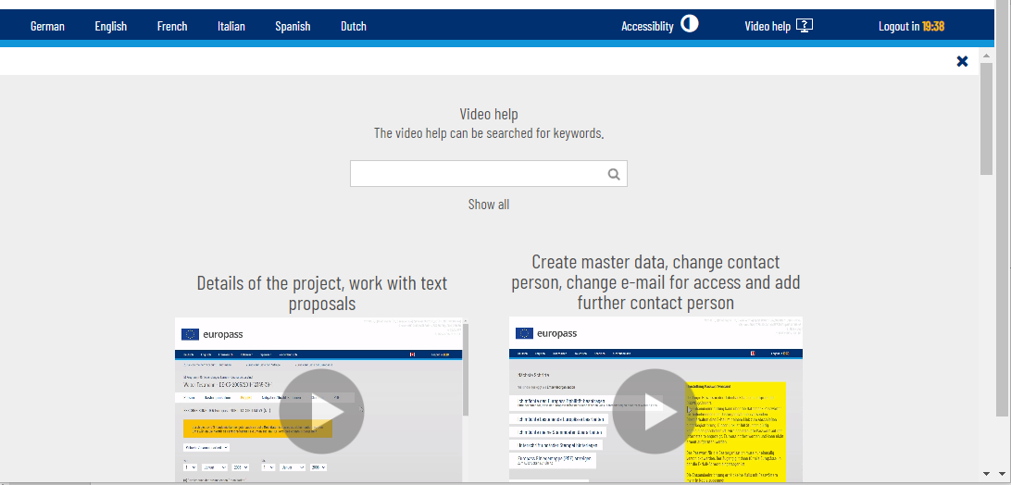
Online Video Helpcenter (DE/EN)
Notes:
More videos on the following features planned:
Deposit signature and stamp
Invite participants, block and release accesess
Understanding status displays
Create participants contracts
Copy contenst to other Europass
Forgotten password
Text formating

Slide 16
More videos planned:
How to deposit signature and stamp
How to invite participants, block and release accesess
Understanding status displays
Create participants contracts
Copy content to other Europass documents
Forgotten password
Text formatting
Notes:
More videos on the following features planned:
Deposit signature and stamp
Invite participants, block and release accesess
Understanding status displays
Create participants contracts
Copy contenst to other Europass
Forgotten password
Text formating

Slide 17
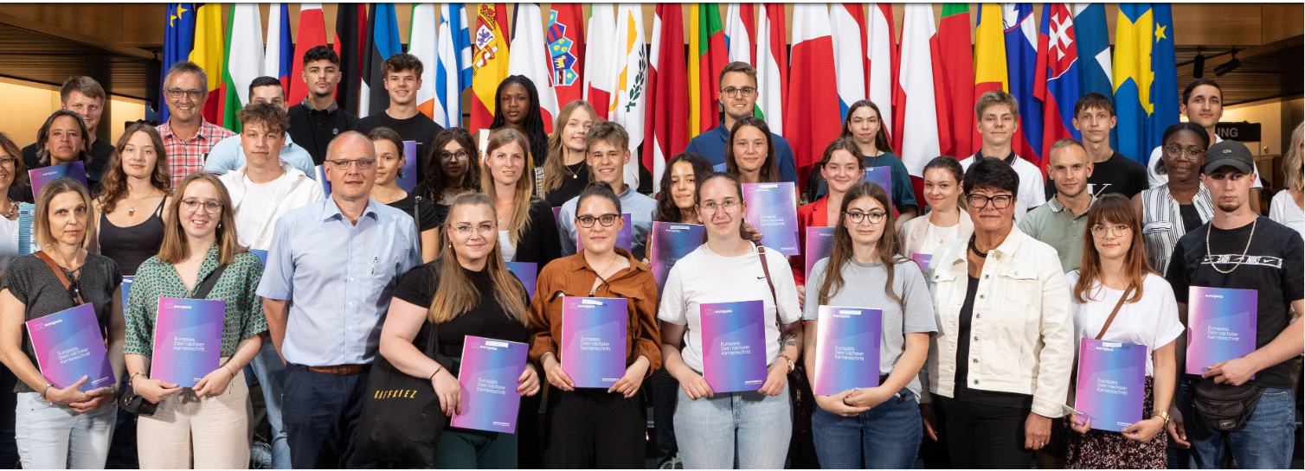
2. Europass Mobility Award Ceremony in the European Parliament July 2022

Slide 18
Good practice NEC Austria
Carola Fank
Carola.Fank@oead.at

Slide 19
Good practice and developments – NEC Austria
New guide: Mobility step-by step as a Prezi and pdf https://www.europass.at/was-ist-europass/mobilitaetsnachweis/mobilitaetsnachweis-step-by-step/
New folder designed and produced
Mobility document provided for all participants from 33 countries in Euroskills Graz 2021
Europass mobility competition for 30,000 mobilities 2021
Study on accessibility of database, risks eliminated 2022
Notes:
© iStock/sumnersgraphicsinc

Slide 20
Good practice and developments – Nec Austria II
Developments in the database:
Virtual mobility implemented
Automatic buffering of all inputs
Display of any tabs for persons and guest organisations in read-only mode
Easier identification of participants by including the name in the PDF
Notes:
© iStock/sumnersgraphicsinc

Slide 21
Good practice NEC Hungary
Baranyi Diána
diana.baranyi@tpf.hu

Slide 22
HU NEC - EM EDITOR (europass.tpf.hu)
The Europass Mobility editor does not require any registration, therefore anyone can easily access it.
The document is available in English, French, German and Hungarian languages. (These are the most popular languages used by Hungarian users.)
None of the given personal data is stored by the system, because there is no database behind the editor.
The completed mobility document becomes downloadable with a click. Thanks to the PDF-XML format, users can import it to the editor again, so they can re-edit and expand it later. However, it is important that the document becomes validated only after it is printed and signed and stamped. (no digital signature module)
The editor generates the document number by itself, if the user fills the personal data fields.

Slide 23
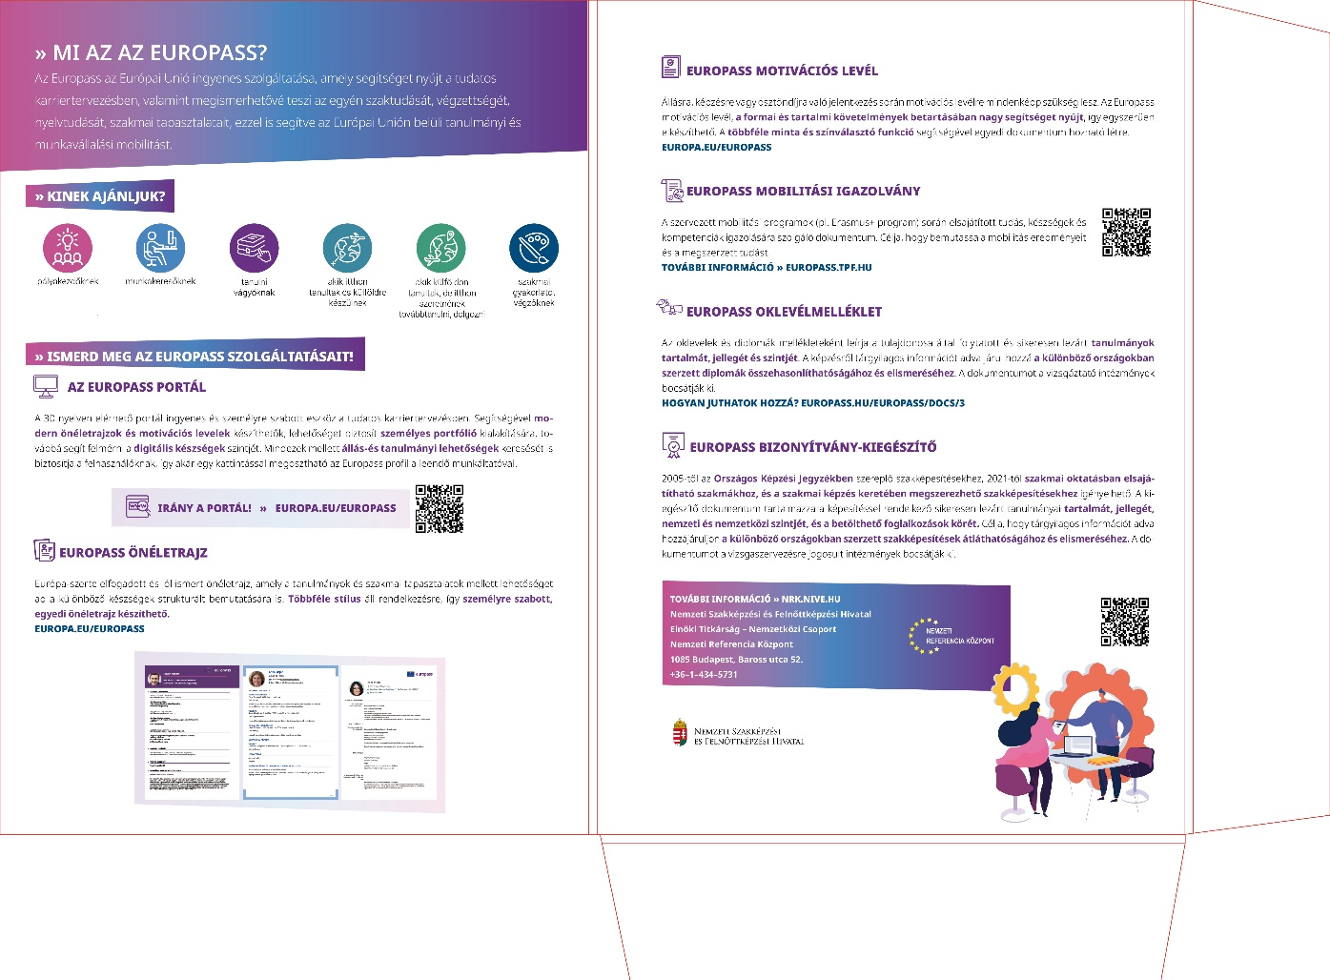
HU NEC FOLDER
TEMPLATE

Slide 24
Good practice NEC Slovenia
Špela Pogačnik Nose
spela.pogacnik@cpi.si

Slide 25
New features issue EM
DEMO VERSION: for sending partner
POSSIBILITY TO ISSUE FOR INCOMING
INTEROPERABILITY WITH EM TOOL: data of institution
ONLY ONE SIGTANTURE OBLIGATORY: host partner signature is not obligatory

Slide 26
Issue during corona times
2019: 2030
2020: 646
2021: 1084
2022: 1448 (8 months)

Slide 27
Thank You
Discussion

